Slide 1
Personal Software Engineering
Overview

Slide 2
Food for thought
Write your name on sheet of paper number/answer the following:
1) What would be your ideal experience for this class?
3) What do you feel is your biggest weakness as a Software person?
2) What is the most important thing one needs to learn to become a successful Software Engineer?
3b) How would you go about improving on it?

Slide 3
What we want you to learn in SWEN-250
Learning the foundations of software
Using the basic tools (Command line, compilers, version control …)
Writing ‘clean’ code
How in read/ interpret instructions (requirements)
Managing your time (your ‘personal’ software process)
Being an engineer (not just a coder)
You will learn all this using Unix, C, C++, git …

Slide 4
Topics
Syllabus and Schedule
Questions?

Slide 5
Process
Read
Design
Implement
Test
Think
Iterate!

Slide 6
Tech stack
Gitlab (git.gccis.rit.edu)
hamilton/ linux
Command line
C/ C++

Slide 7
Other details…
•Always (double)check submission has been made
•Deadlines are stated on course schedule. You may be offered additional time during class but this won’t be the norm.
•When in doubt:
–Check the one-stop-shop schedule, the syllabus, myCourses
–If after that you are still unsure, ask.
•Let’s get to know each other and have fun!

Slide 8
To share or not to share …

Slide 9
Programs versus Software Products
Programs | Software Products
Usually small in size | Large
Author himself is sole user | Large number of users
Single developer | Team of developers
Lacks proper user interface | Well-designed interface
Lacks proper documentation | Well documented & usermanual prepared
Ad hoc development | Systematic development

Slide 10
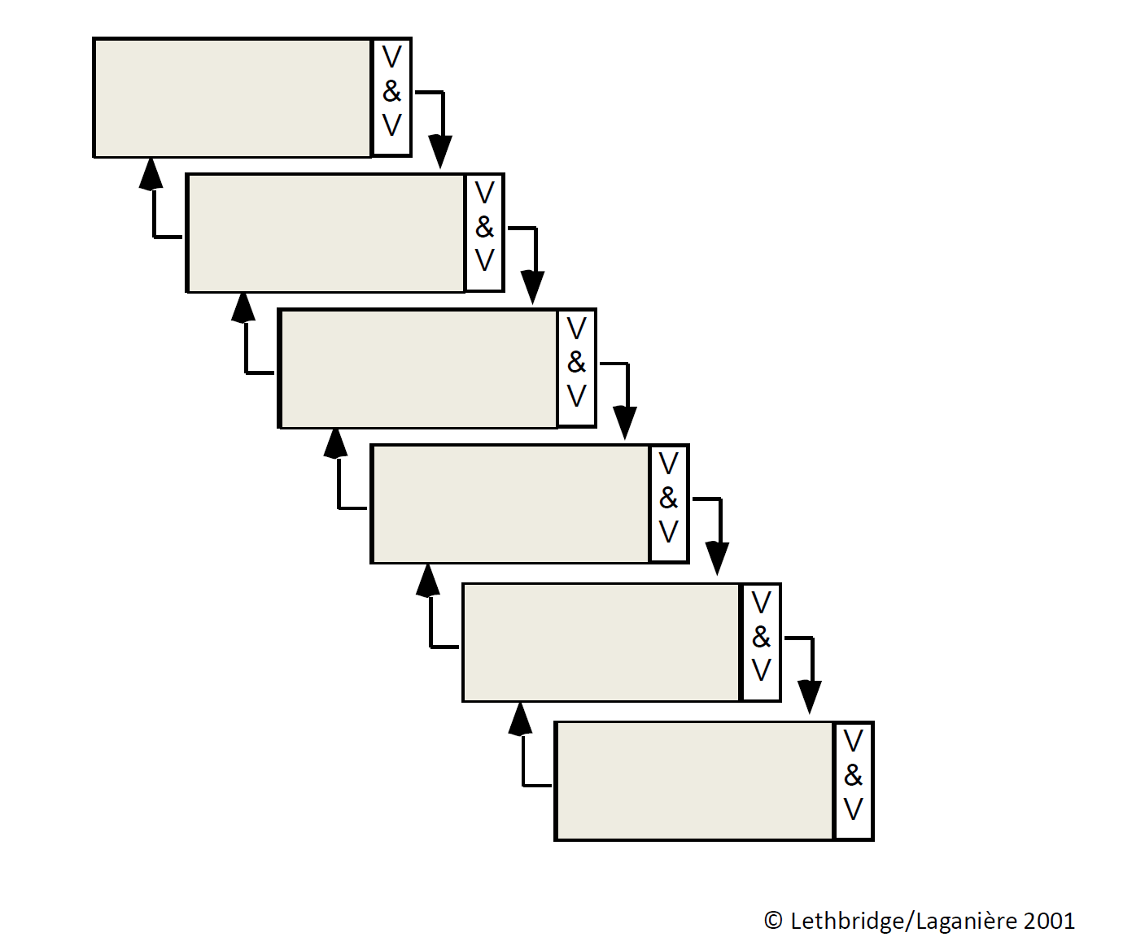
The waterfall model

Slide 11
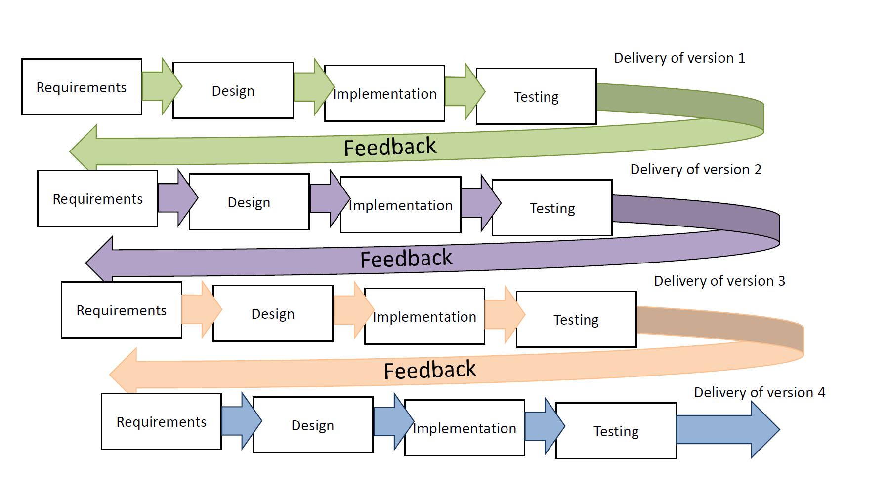
Incremental Development

Slide 12
Defining a Personal Process
•What is a Process?
•Why Personal?
•5W’s + H
Why What
Who When
Where How
•People + Process + Product + Technology

Slide 13
Defining a Personal Process (cont)
•Tools + Personal Habits
•Continuous and Incremental integration
•Reflection and Improvement
•Metrics for success

Slide 14
SE Accounts
•Not your RIT main account
•Same password as RIT main?

Slide 15
Linux Environment Intro
•nitron.se.rit.edu hamilton.se.r.it.edu
SE Dept. main shared server
All SE students have an account (not the same as your RIT ‘main’ account)
•Z:/ → Shared/ global drive. No matter where you login, you will see this mapped
•ssh (secure shell)
See instructions on setting up and using
•Basic commands
•http://www.ee.surrey.ac.uk/Teaching/Unix/
Work on tutorial #1 and #2

Slide 16
How you do your work …
On your desktop …
Open a terminal (e.g. Windows Terminal … or powershell or mac terminal)
Connect to hamilton (see instructions for hamilton, ssh)
Navigate to your repo local folder (see instructions for gitlab)
Edit/ compile/ test your code (all command line!)
Push your code to gitlab (also command line)
Repeat (often)

